Slide 1
Mood based Search Engine for songs and Lyrics
Created By -
Manali Joshi
Rohan Giri
Siddhanta Borikar
Likita Reddy

Slide 2
Agenda
Problem Statement
Implementation Roadmap
Techniques Used
Search Algorithm
User Interface
User Testing
Challenges and Important Design Decisions
Demonstration
Q&A
Steps for Project Implementation
Identified Data Source

Slide 3

Problem Statement
A search engine that takes user input in the form of an emotion that the user is feeling and lists out songs and corresponding lyrics which match that emotion.

Slide 4
Implementation Roadmap
Selecting a Data Source
Scraping the site to get all the song and lyrics
Cleaning the data
Vectorization
Array of all songs
Cosine Similarity for matching query and results
Integration with HTML webpage as Frontend
User Testing

Slide 5


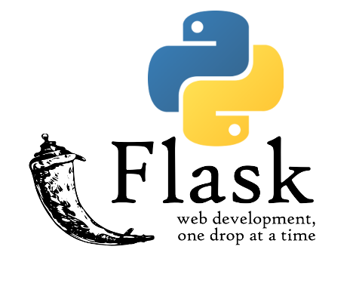
Techniques Used
Scraping the site to get all the song and lyrics --> SiteSucker
Cleaning the data --> Spacy
Vectorization --> Spacy
Array of all songs --> Numpy.array()
Cosine Similarity for matching query and results -->scikit-learn
Integration with HTML webpage as Frontend --> Flask
User Testing

Slide 6
Search Algorithm
The search algorithm is based on mapping vector values
The user input is converted into its vector representation.
All the songs in the database are vectorized and stored in an array.
The cosine similarity is calculated between the user query and the available songs vector matrix.
The closest matching values and hence the corresponding songs are returned to the user on the web page.

Slide 7
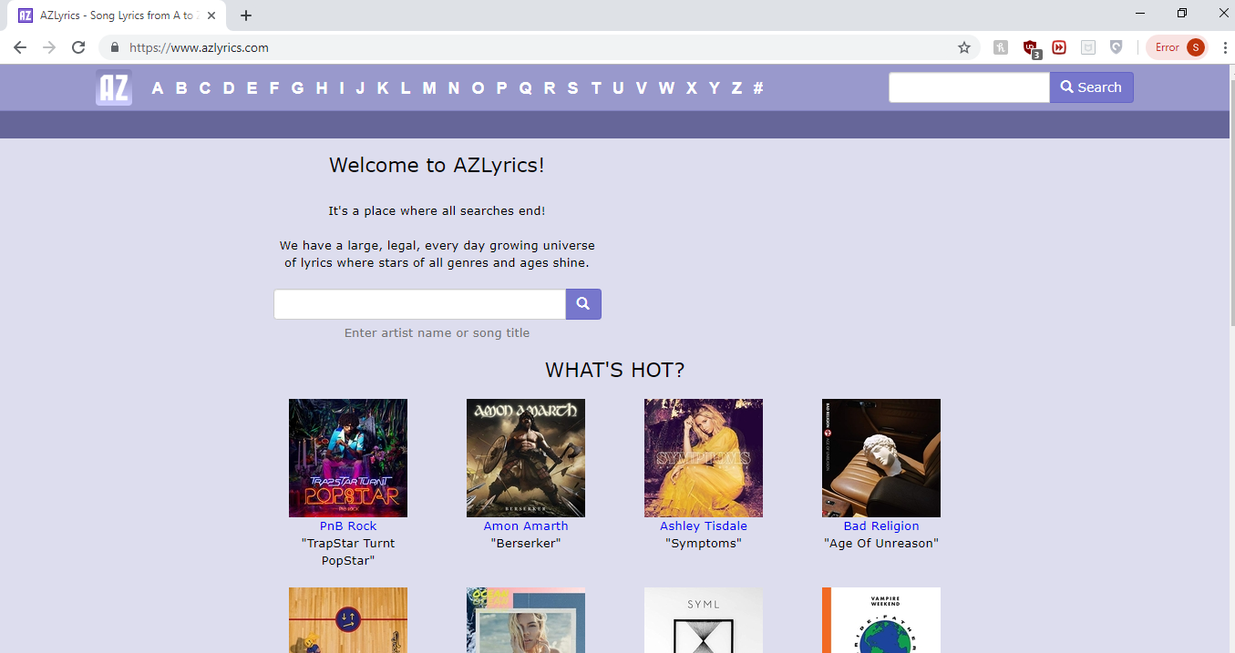
Identified Data Source
Picked a data source that would guarantee to have all songs ever made and that it is frequently updated so that we have an updated repository as well.
www.azlyrics.com

Slide 8
Data Scraping
Used SiteSucker which is an application that automatically downloads websites from the data source – azlyrics.com and asynchronously copies the site's webpages to the local hard drive.

Slide 9
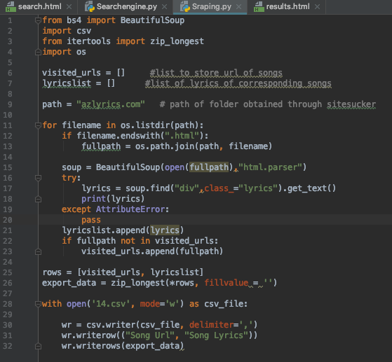
Parsing HTML pages using BeautifulSoup
Used Python package Beautiful Soup for parsing HTML documents stored in scraped data folder. We extracted data from HTML page with lyrics and stored song name and its lyrics in a CSV file for further processing which is useful for web scraping.

Slide 10
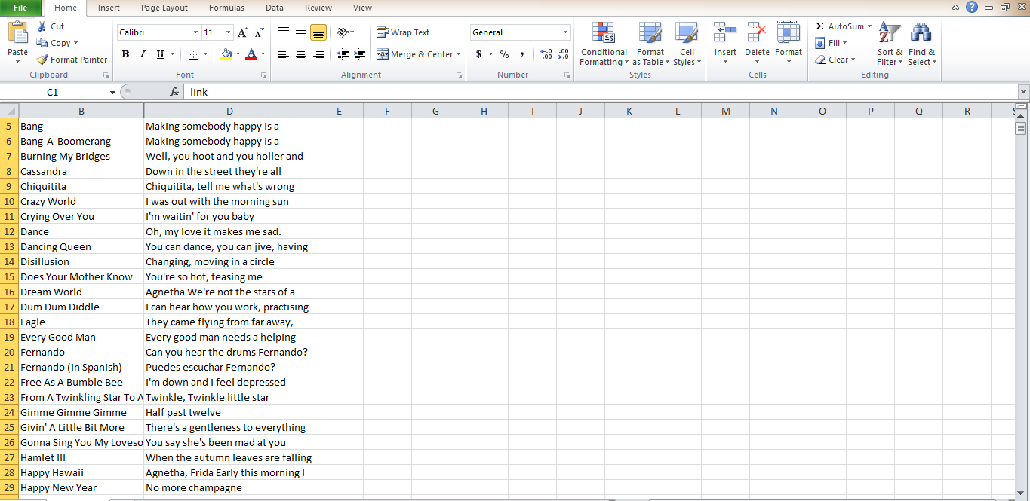
Data File

Slide 11
Lemmatization and Vectors
Data
Used Spacy to remove stopwords and lemmatize each word in all the lyrics in the database.
Obtained vector representation of every song lyrics and stored the vector representation in 2D numpy array.
Query
Simultaneously created a list of words of different emotions and stored its vector in 1D numpy array
Reshaped the numpy array from 1D to 2D to reduce the complexity in obtaining cosine similarity.

Slide 12
Cosine Similarity
Cosine similarity is a function which computes the degree of similarity between a pair of vectors.
In this case, we represent the similarity between one song lyrics (document) and one query.
By calculating cosine of the angle between the vectors we get the similarities between 0 to 1. Closer the value to 1, more the similarity between query and the song lyrics.
We stored the cosine similarity values in a list and retrieved the maximum 10 values from it which are basically the top 10 songs.

Slide 13
Indices and DataFrame
After getting the maximum 10 values from the cosine list, we obtained the corresponding song lyrics by passing the same index values to the song lyrics list.
The song name and song lyrics obtained through list indices are saved as pairs in a list and passed to Pandas DataFrame.

Slide 14
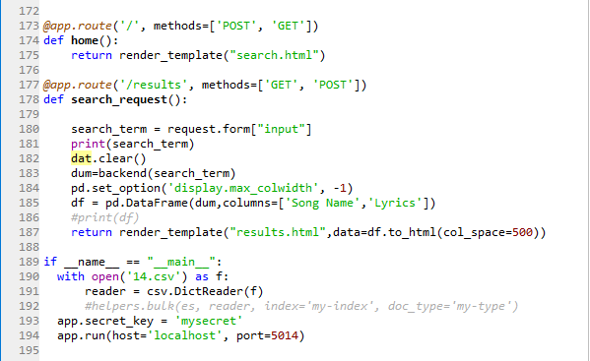
Front-end Development
Developed the front-end using Flask which is a microframework for Python.
The website is running on local host server on the port 5014.
route() is used to tell Flask what URL should trigger our function.
The function is given a name which is also used to generate URLs for that particular function and returns the message we want to display in the user’s browser.

Slide 15
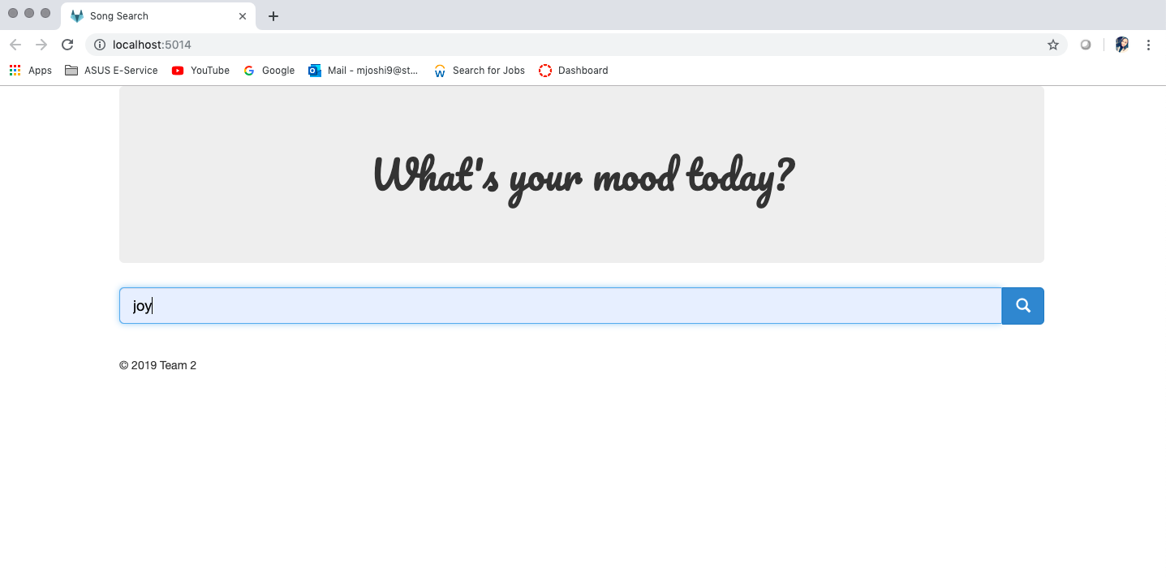
User Interface – Search Page

Slide 16
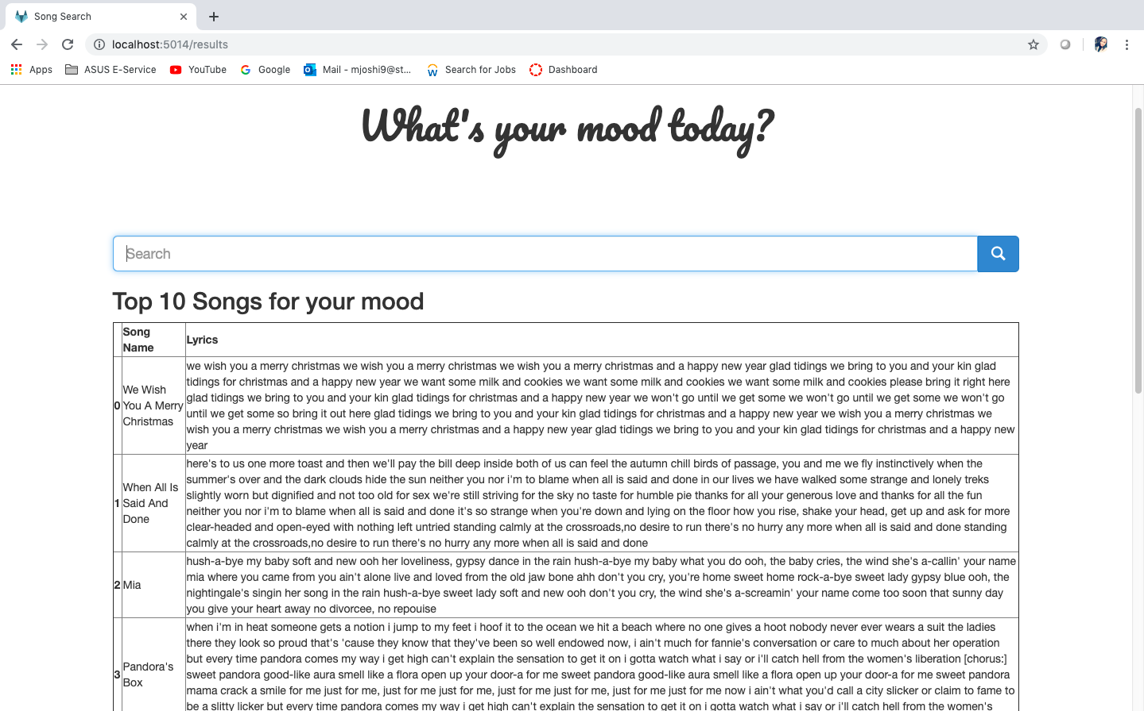
User Interface – Results Page

Slide 17
Challenges and Important Decisions
Challenges and important decisions throughout the process:
Data Source selection
NLTK or Spacy for data cleaning/preparation
Integration of frontend HTML pages with backend Python code
Mapping of user query with the existing database to return results
Returning list of appropriate songs.

Slide 18

Demonstration

Slide 19

Any Questions?

